Slide 1
MALIGNANT COMMENTS CLASSIFICATION

Slide 2
Problem Statement-
Build a model using Machine Learning in order to build a prototype of online hate and abuse comment classifier which can used to classify hate and offensive comments so that it can be controlled and restricted from spreading hatred and cyberbullying.

Slide 3
Problem Understanding-
The proliferation of social media enables people to express their opinions widely online. However, at the same time, this has resulted in the emergence of conflict and hate, making online environments uninviting for users. Although researchers have found that hate is a problem across multiple platforms, there is a lack of models for online hate detection.
Online hate, described as abusive language, aggression, cyberbullying, hatefulness and many others has been identified as a major threat on online social media platforms. Social media platforms are the most prominent grounds for such toxic behaviour. There has been a remarkable increase in the cases of cyberbullying and trolls on various social media platforms. Many celebrities and influences are facing backlashes from people and have to come across hateful and offensive comments. This can take a toll on anyone and affect them mentally leading to depression, mental illness, self-hatred and suicidal thoughts.
Internet comments are bastions of hatred and vitriol. While online anonymity has provided a new outlet for aggression and hate speech, machine learning can be used to fight it. The problem we sought to solve was the tagging of internet comments that are aggressive towards other users. This means that insults to third parties such as celebrities will be tagged as unoffensive, but “u are an idiot” is clearly offensive.

Slide 4
EDA Steps and Visualization

Slide 5
The train datasheet is extracted and saved in a dataframe
The shape of the dataframe is checked-
There are 159571 rows and 8 columns
The columns are as follows-
id
comment_text
malignant
highly_malignant
rude
threat
abuse
loathe

Slide 6
The data type of each column is-
id - object
comment_text - object
malignant - int64
highly_malignant - int64
rude - int64
threat - int64
abuse - int64
loathe - int64
There are no null values are present in the dataset
As the id is unique to all, its safe to drop this column

Slide 7
The data visualization, value counts encoding and imputation of null values for each column

Slide 8
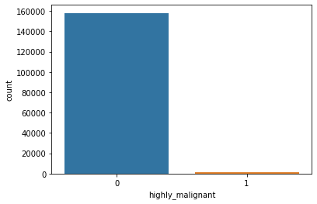
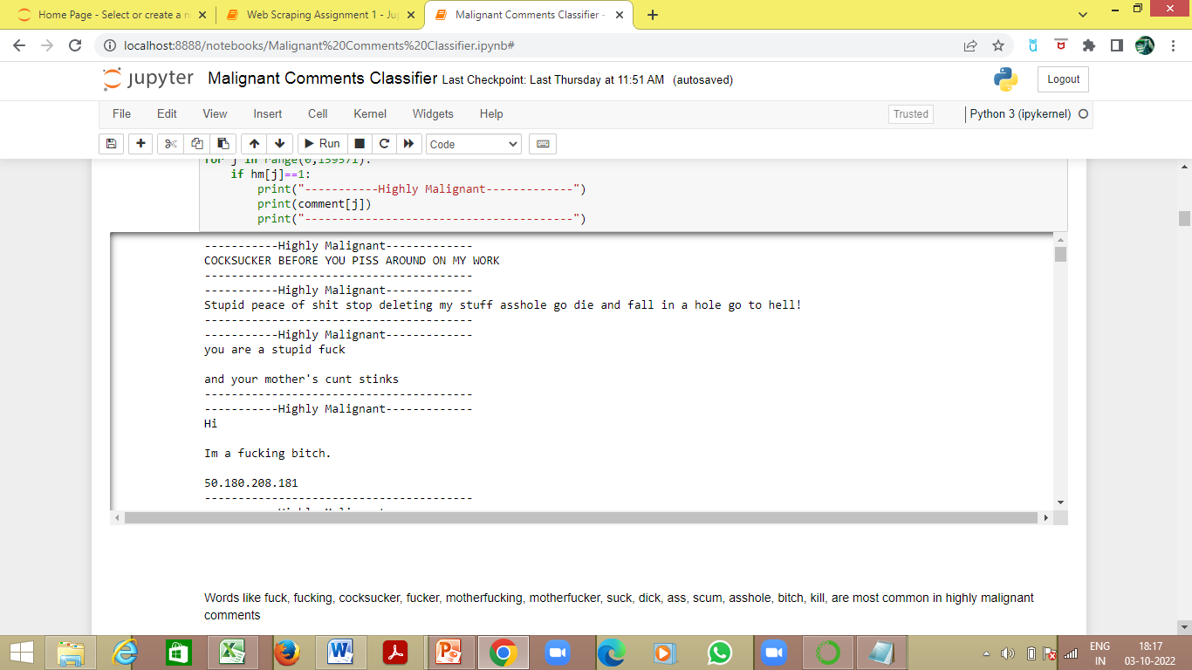
highly_malignant
Binary column with labels for highly malignant text. .
comment_text
It includes the comment text.
1595 comments are highly malignant
Encoding object data in numeric using Label Encoder
Words like fuck, fucking, cocksucker, fucker, motherfucking, motherfucker, suck, dick, ass, scum, asshole, bitch, kill, are most common in highly malignant comments

Slide 9
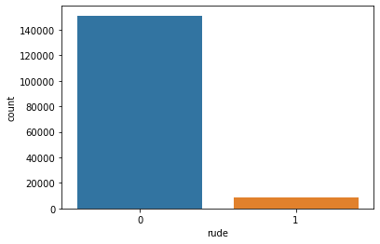
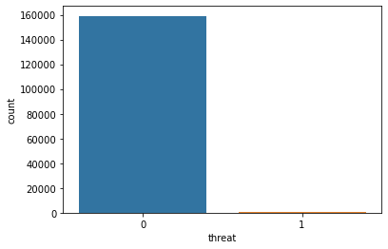
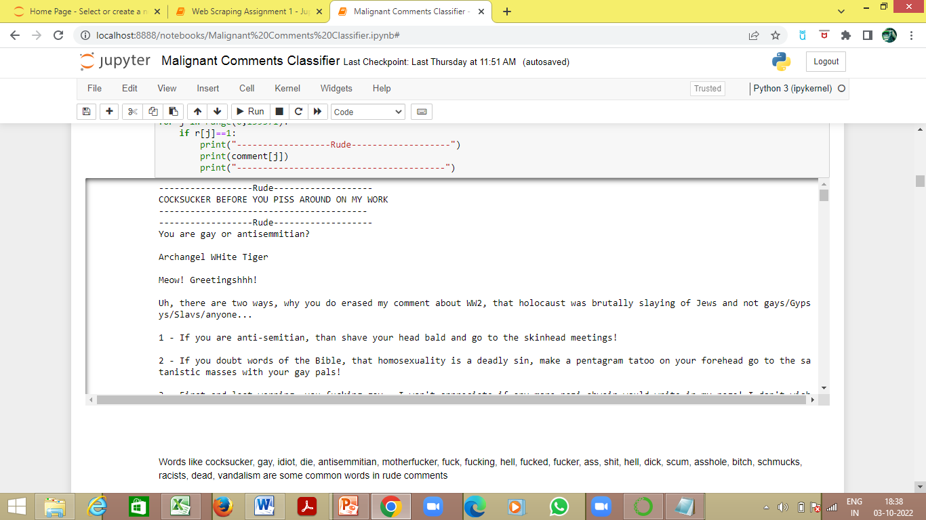
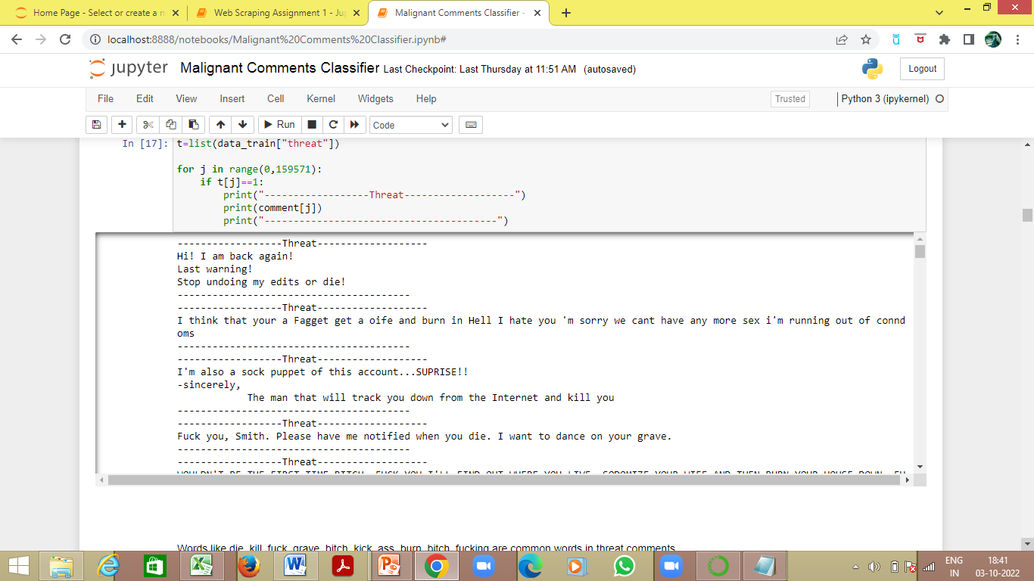
rude
Binary column with labels for comments that are rude in nature.
threat
Binary column with labels for threatening context in the comments.
8449 comments are rude in nature
478 comments are threatening
Words like cocksucker, gay, idiot, die, antisemmitian, motherfucker, fuck, fucking, hell, fucked, fucker, ass, shit, hell, dick, scum, asshole, bitch, schmucks, racists, dead, vandalism are some common words in rude comments
Words like die, kill, fuck, grave, bitch, kick, ass, burn, bitch, fucking are common words in threat comments

Slide 10
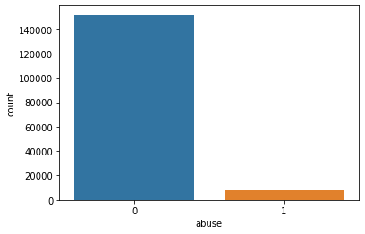

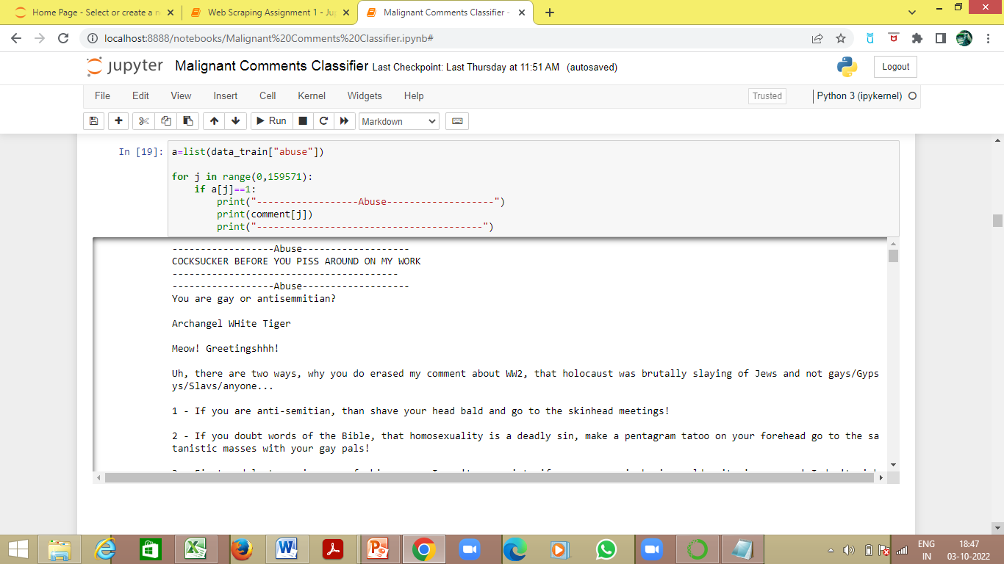
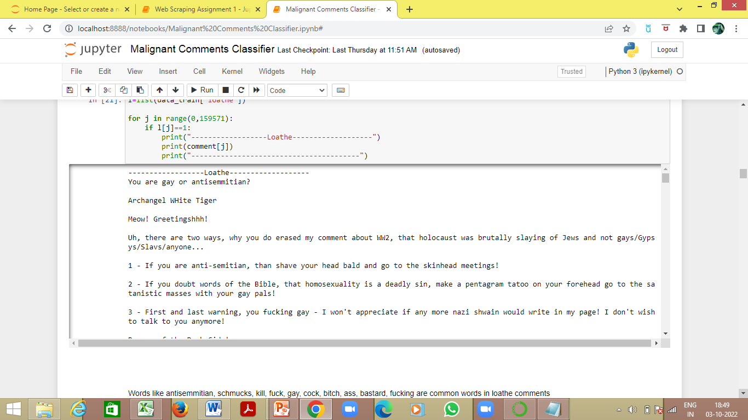
abuse
Binary column with labels with abusive behaviour.
loathe
Label to comments that are full of loathe and hatred.
7877 comments are abusive
1405 comments are full of loathe and hatred
Words like gay, antisemmitian, cocksucker, fuck, ass, cunts, schmuck, kill, asshole, idiot are common words in abuse comments
Words like antisemmitian, schmucks, kill, fuck, gay, cock, bitch, ass, bastard, fucking are common words in loathe comments

Slide 11
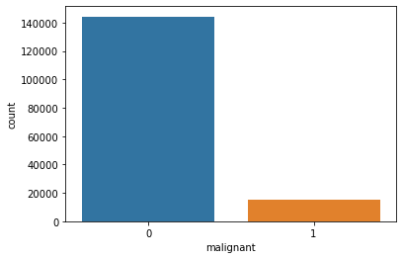
Label
malignant
It is a column with binary values depicting which comments are malignant in nature.
15294 comments are malignant in nature

Slide 12
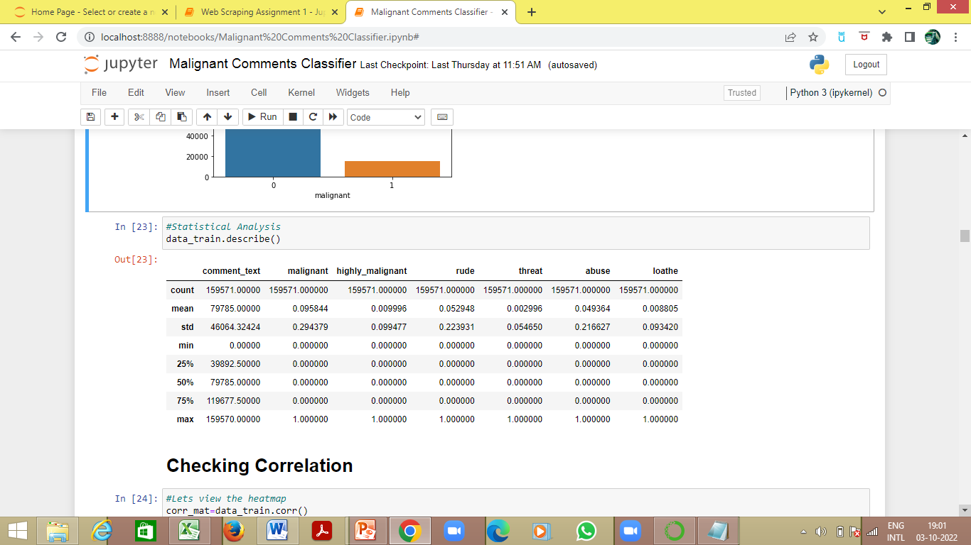
Statistical analysis using describe method-

Slide 13
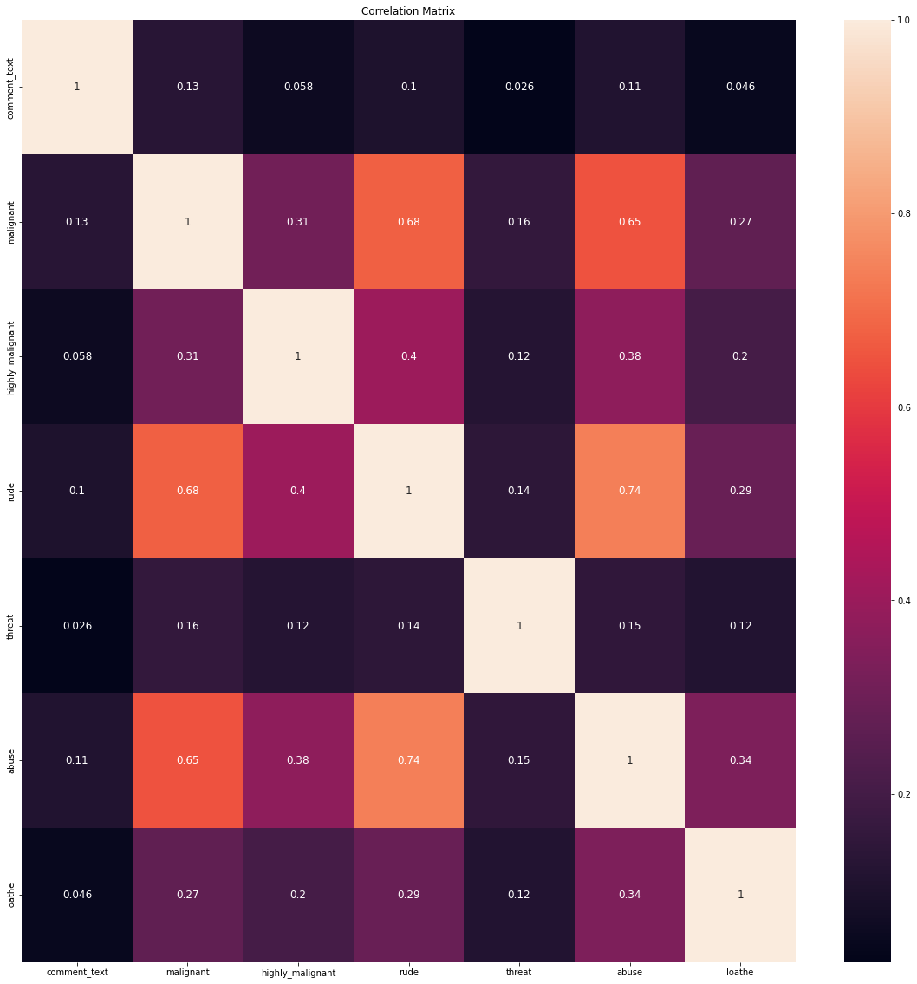
The Correlation Matrix using heatmap

Slide 14
Correlation between the columns and the label ‘malignant’ using corr method-
malignant : 1.000000
rude : 0.676515
abuse : 0.647518
highly_malignant : 0.308619
loathe : 0.266009
threat : 0.157058
comment_text : 0.132016
rude is 67% positively correlated to ‘malignant’
abuse is 64% positively correlated to ‘malignant’
highly_malignant is 30% positively correlated to ‘malignant’
loathe is 26% positively correlated to ‘malignant’
threat is 15% positively correlated to ‘malignant’
comment_text is 13% positively correlated to ‘malignant’

Slide 15
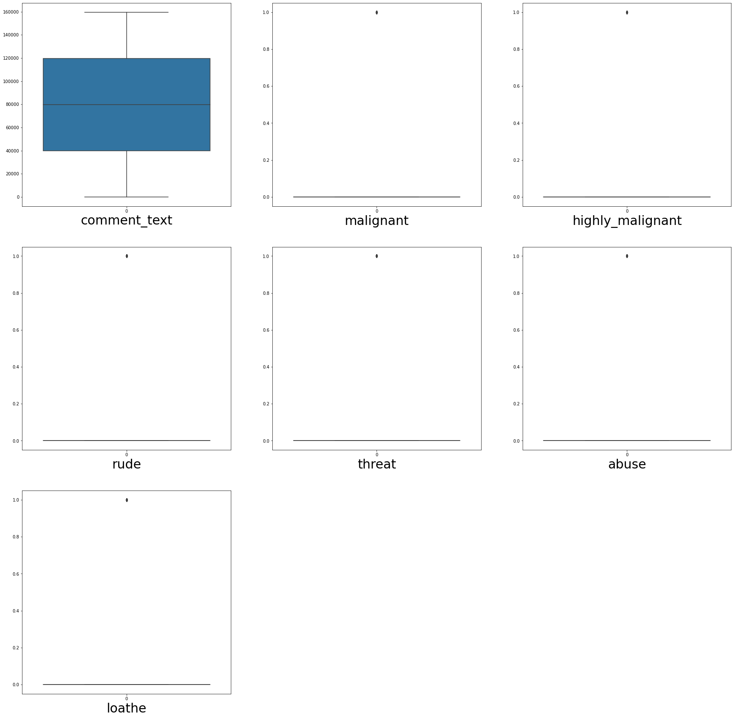
Visualizing outliers using boxplot method-

Slide 16
Removing outliers using zscore method-
On removing the outliers the data loss is 10.17%, which is not acceptable, hence outliers are tolerated
The dataset is divided into x_train (features) and y_train (label)-
The x_train contains all the features other than the label ‘malignant’
The y_train contains only the label ‘malignant’

Slide 17
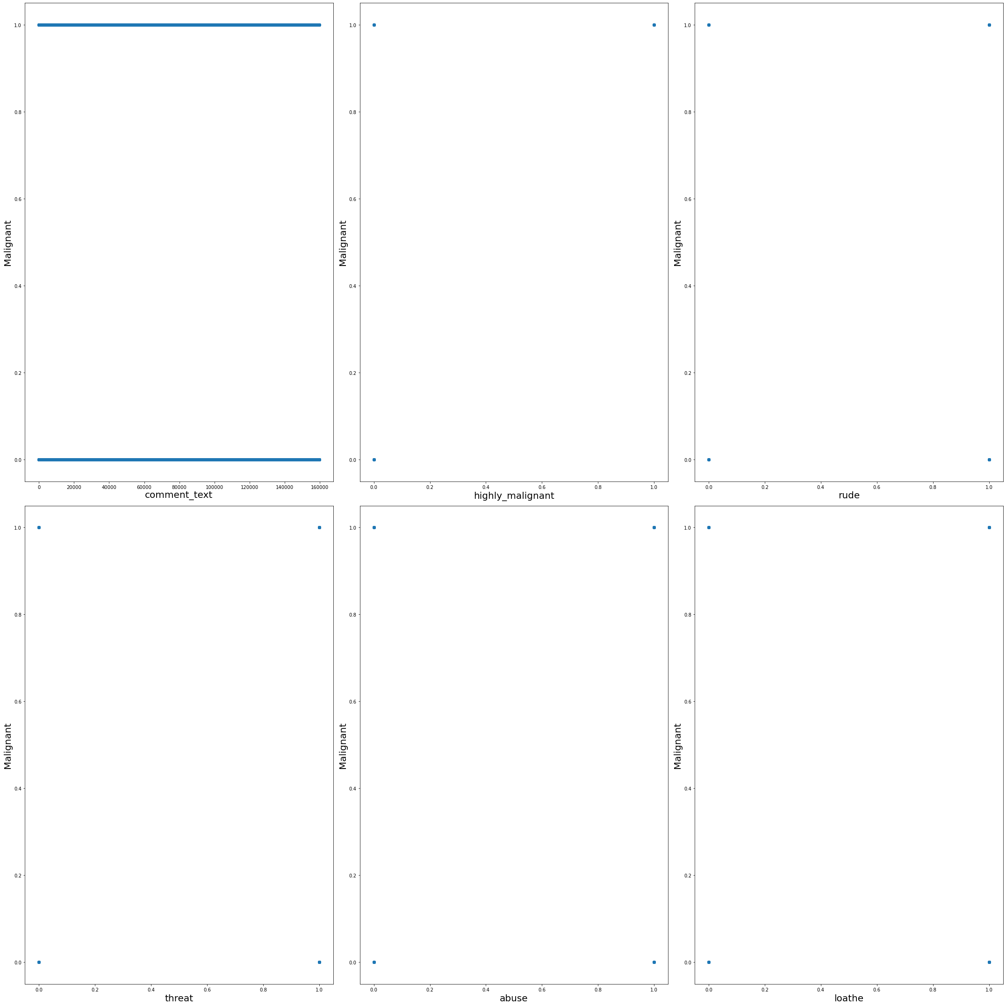
Visualizing relationship between features and label-

Slide 18
The skewness observes in graphical analysis was confirmed by using the skew method-
threat : 1.818900e+01
loathe : 1.051592e+01
highly_malignant : 9.851722e+00
abuse : 4.160540e+00
rude : 3.992817e+00
comment_text : 1.282301e-19
This skewness was removed using the power transformer
The x_train(features) were scaled using the Standard Scaler

Slide 19
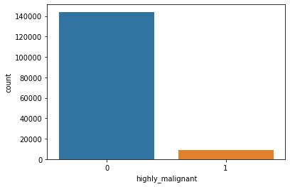
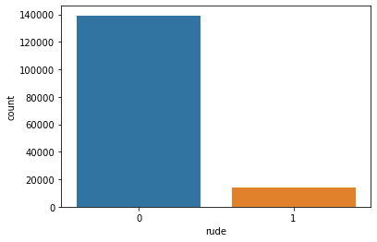
The test datasheet and saved in another dataframe
The shape of x_test is 153164 rows and 2 columns
highly malignant column is added by filtering comments containing the words common in highly malignant comments in the train dataset
rude column is added by filtering comments containing the words common in rude comments in the train dataset
9111 comments are highly malignant
13876 comments are rude in nature

Slide 20
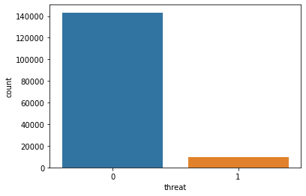

threat column is added by filtering comments containing the words common in threat comments in the train dataset
abuse column is added by filtering comments containing the words common in abuse comments in the train dataset
9851 comments are threatening
9510 comments are abusive in nature

Slide 21

loathe column is added by filtering comments containing the words common in loathe comments in the train dataset
comment_text
It includes the comment text.
Encoding object data in numeric using Label Encoder
As the id is unique to all, its safe to drop this column
9217 comments are full of hatred and loathe

Slide 22
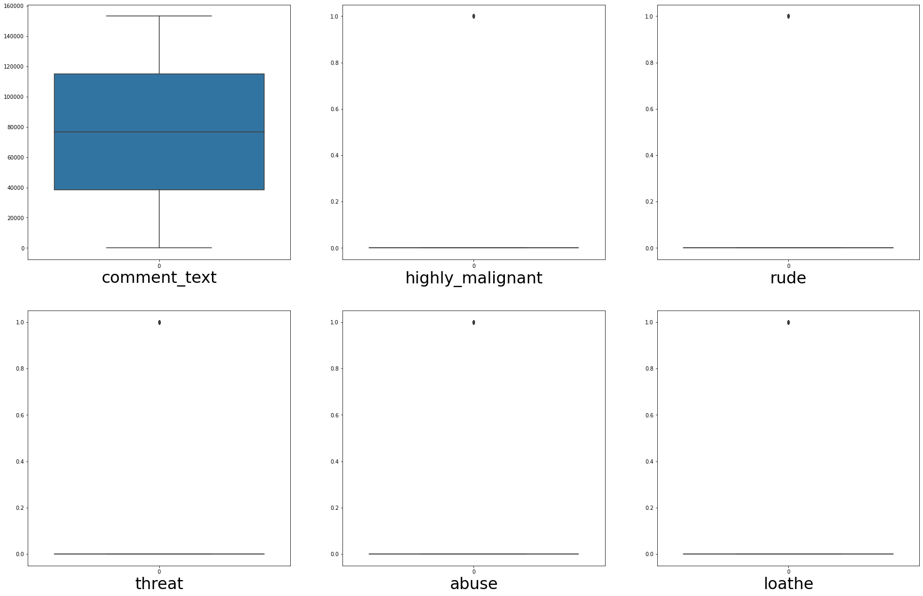
Visualizing outliers using boxplot method-
Removing outliers using zscore method-
On removing the outliers the data loss is 10.27%, which is not acceptable, hence outliers are tolerated

Slide 23
The skewness observes in graphical analysis was confirmed by using the skew method-
highly_malignant : 3.724837e+00
loathe : 3.698899e+00
abuse : 3.629329e+00
threat : 3.552049e+00
rude : 2.852688e+00
comment_text : 1.510704e-18
This skewness was removed using the power transformer
The x_test were scaled using the Standard Scaler

Slide 24
The x_train, y_train and x_test were applied on different models as follows

Slide 25
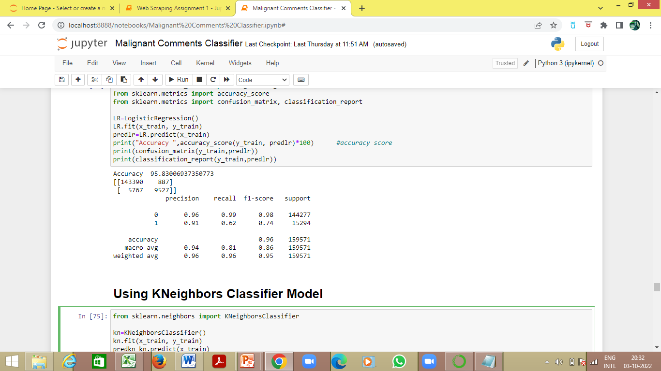
Logistic Regression Model
The Accuracy for y_train and pred_train(data predicted on x_train) is 95.83%
The Confusion Matrix for y_train and pred_train(data predicted on x_train) is –
The Classification Report for y_train and pred_train(data predicted on x_train) is
True Positive
False Positive
143390 | 887
5767 | 9527
False Negative
True Negative

Slide 26
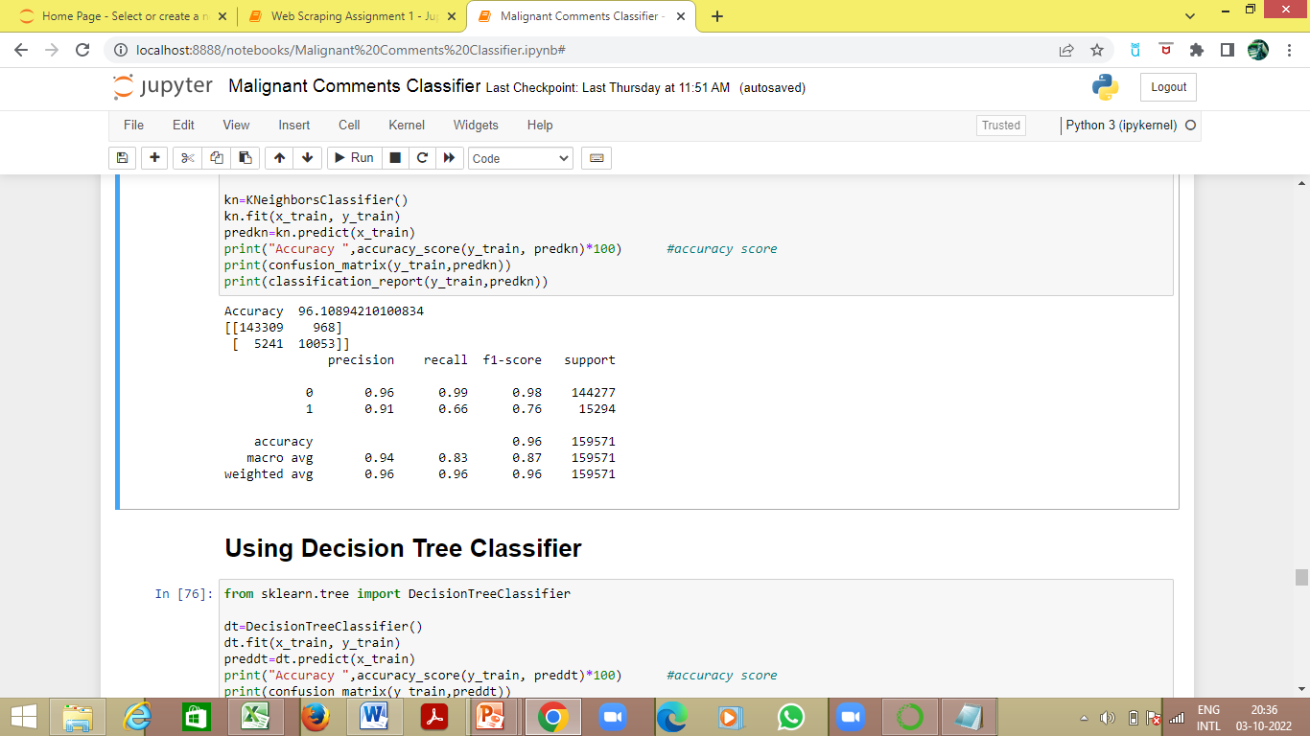
KNeighbors Classifier Model
The Accuracy for y_train and pred_train(data predicted on x_train) is 96.11%
The Confusion Matrix for y_train and pred_train(data predicted on x_train) is –
The Classification Report for y_train and pred_train(data predicted on x_train) is
True Positive
False Positive
143309 | 968
5241 | 10053
False Negative
True Negative

Slide 27
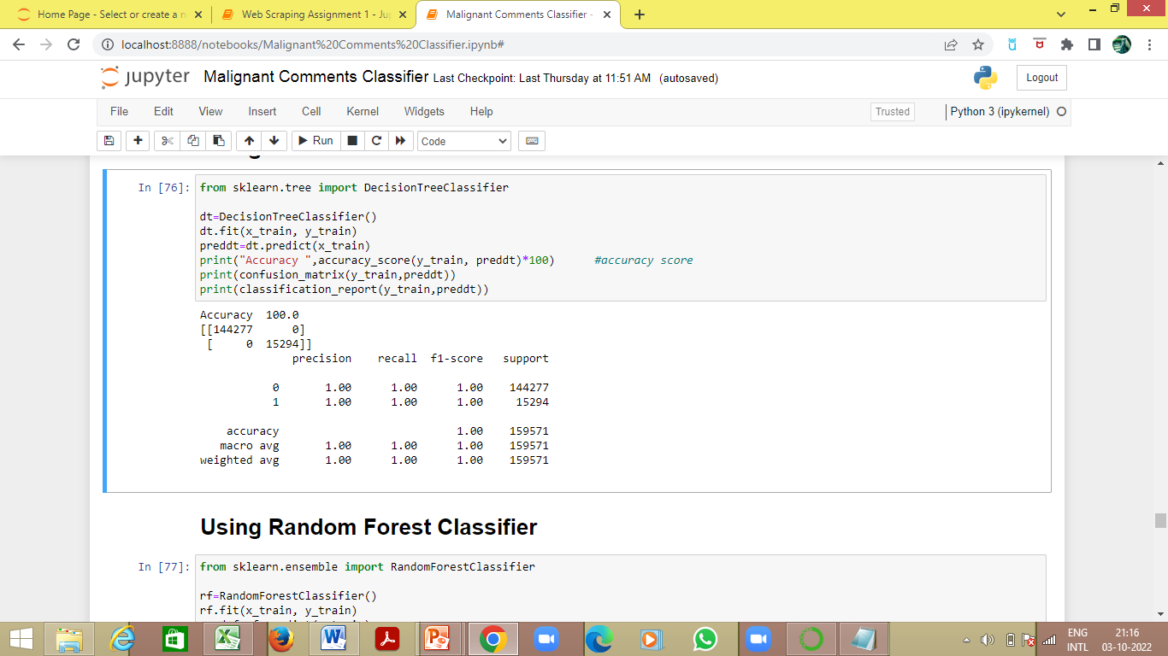
Decision Tree Classifier
The Accuracy for y_train and pred_train(data predicted on x_train) is 100%
The Confusion Matrix for y_train and pred_train(data predicted on x_train) is –
The Classification Report for y_train and pred_train(data predicted on x_train) is
True Positive
False Positive
144277 | 0
0 | 15294
False Negative
True Negative

Slide 28
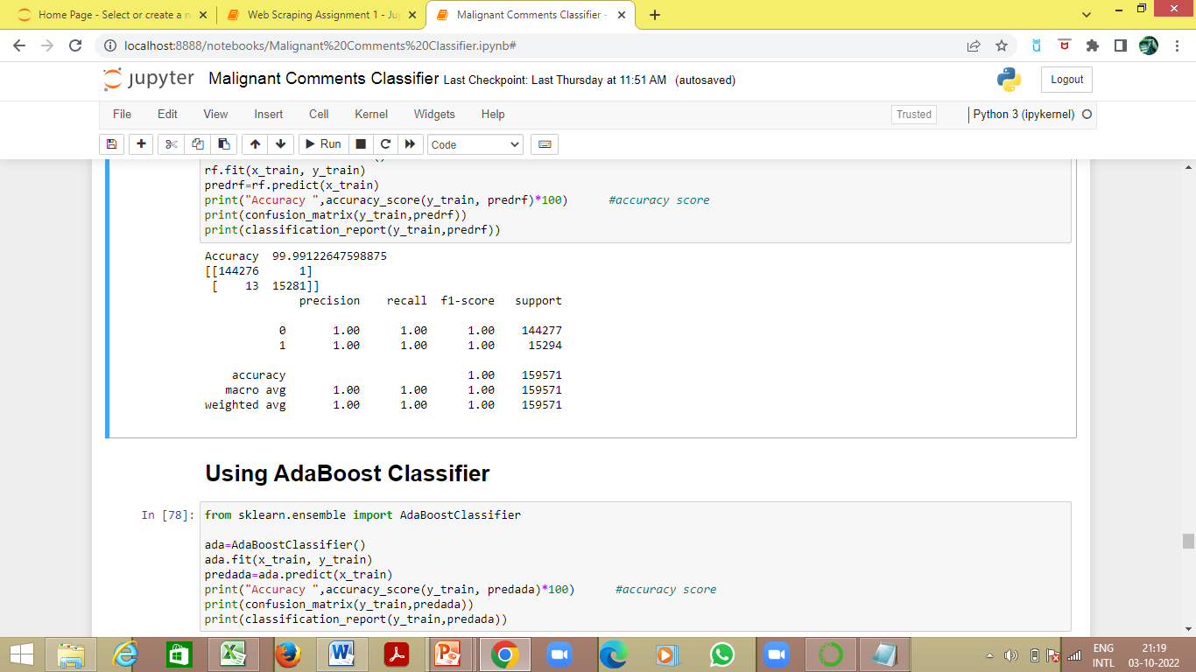
Random Forest Classifier
The Accuracy for y_train and pred_train(data predicted on x_train) is 99.99%
The Confusion Matrix for y_train and pred_train(data predicted on x_train) is –
The Classification Report for y_train and pred_train(data predicted on x_train) is
True Positive
False Positive
144276 | 1
13 | 15281
False Negative
True Negative

Slide 29
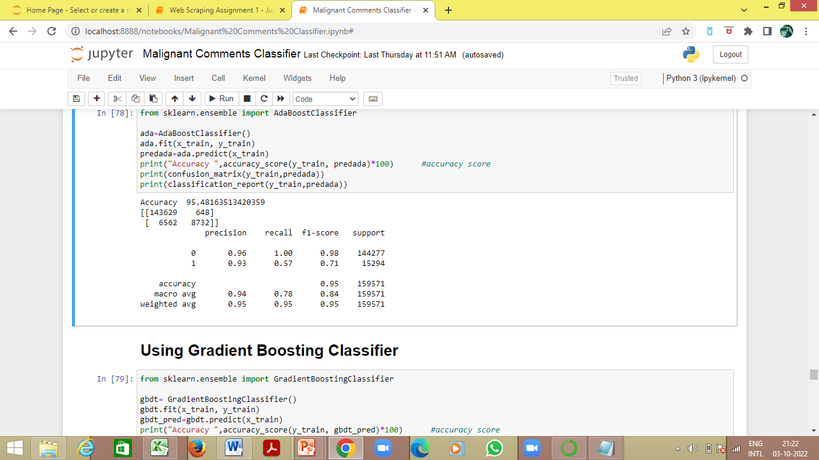
AdaBoost Classifier
The Accuracy for y_train and pred_train(data predicted on x_train) is 95.48%
The Confusion Matrix for y_train and pred_train(data predicted on x_train) is –
The Classification Report for y_train and pred_train(data predicted on x_train) is
True Positive
False Positive
143629 | 648
6562 | 8732
False Negative
True Negative

Slide 30
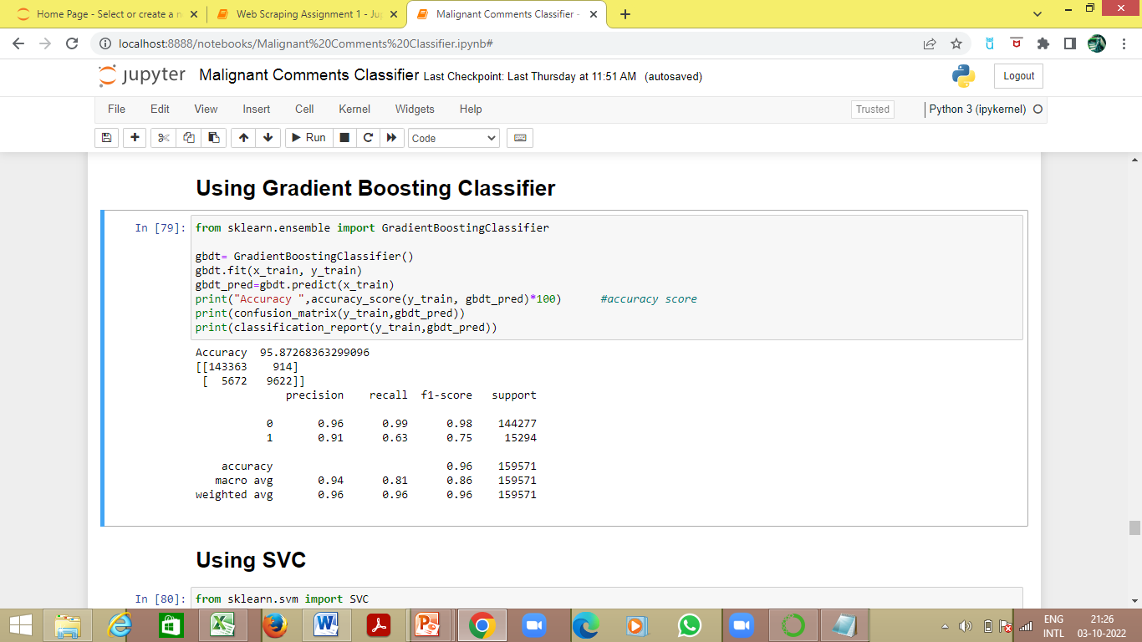
Gradient Boosting Classifier
The Accuracy for y_train and pred_train(data predicted on x_train) is 95.87%
The Confusion Matrix for y_train and pred_train(data predicted on x_train) is –
The Classification Report for y_train and pred_train(data predicted on x_train) is
True Positive
False Positive
143363 | 914
5672 | 9622
False Negative
True Negative

Slide 31
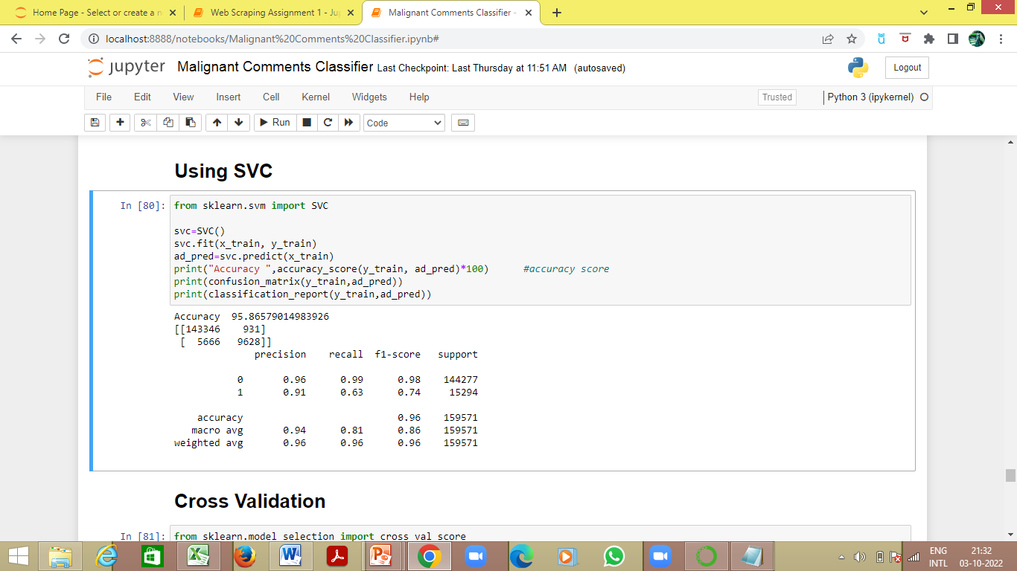
SVC
The Accuracy for y_train and pred_train(data predicted on x_train) is 95.86%
The Confusion Matrix for y_train and pred_train(data predicted on x_train) is –
The Classification Report for y_train and pred_train(data predicted on x_train) is
True Positive
False Positive
143346 | 931
5666 | 9628
False Negative
True Negative

Slide 32
Cross Validation
Model | Cross Validation Score
Logistic Regression | 0.9582
KNeighbor Classifier | 0.9566
Decision Tree Classifier | 0.9289
Random Forest Classifier | 0.9291
Ada Boost Classifier | 0.9546
Gradient Boost Classifier | 0.9586
Random Forest Classifier is performing better, hence it is carried forward

Slide 33
Hyperparameter tuned Random Forest Classifier Model
Random Forest Classifier Model is hyperparameter tuned using GridSearchCV
The best parameters for criterion, max_depth and max_features are found as follows-
criterion: gini
max_depth: 5
Max_features: sqrt
Applying the above found best parameters on Random Forest Classifier Model, the following was obtained-
The Accuracy for target test and pred_test(data predicted on features_test) is 95.87%

Slide 34
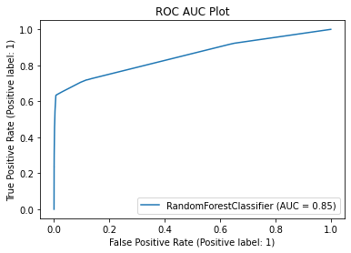
The ROC AUC Plot on the Hyperparameter tuned Random Forest Classifier Model
Final Accuracy is 95.87% and AUC score is 85%, which depicts that our model is working well

Slide 35
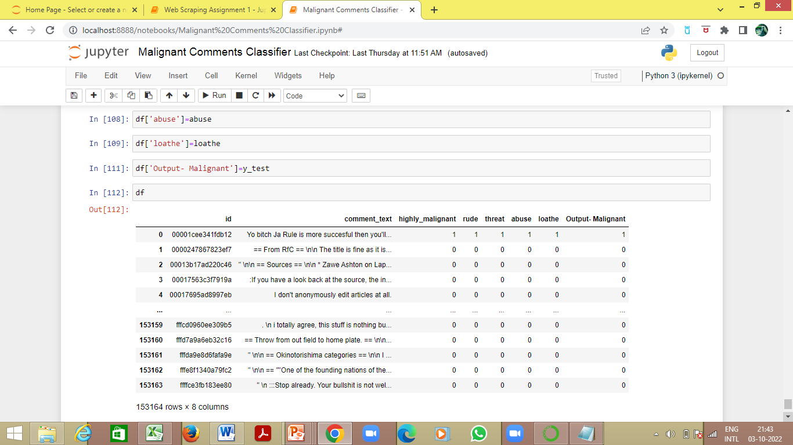
The test data (x_test) is fit into the Hyperparameter tuned Random Forest Classifier Model and the comments are classified as malignant (1) or non-malignant (0)

